Slide 1

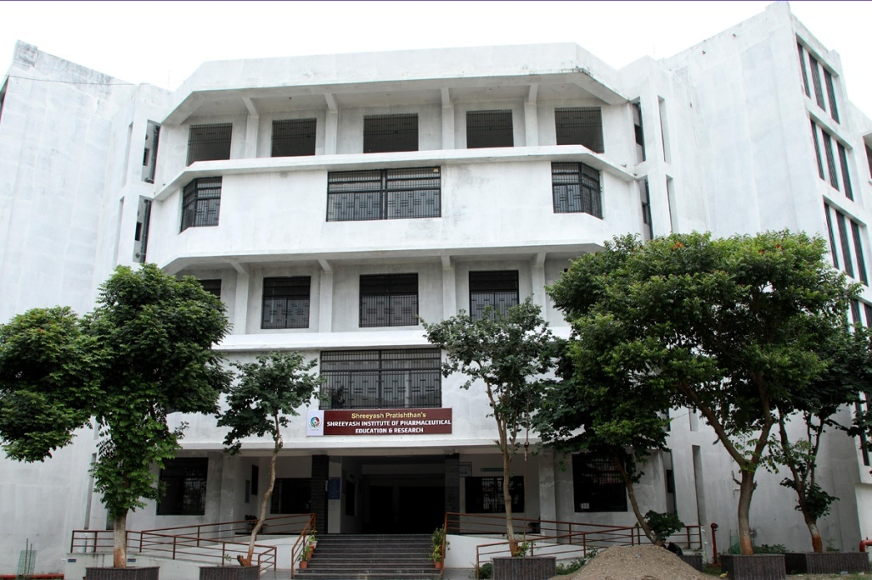
Shreeyash Institute of Pharmaceutical Education and Research, Aurangabad

Slide 2

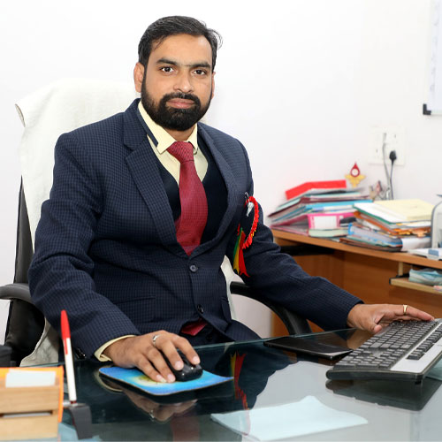
Dr. Ganesh Tapadiya
Principal
Qualification – M. Pharma , Ph. D
Experience – 16 Years
Paper Published : 54
Book Published: 05
Patent - 02

Slide 3

Department of Pharmaceutics

Slide 4
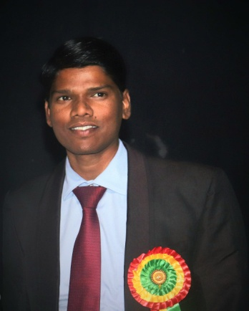
Faculty Name - Dr. Milind D. Kamble
(HoD – Pharmaceutics)
Qualification – M. Pharma (Bio-pharmaceutics)
Ph. D in Pharmaceutics
Experience – 15 Years
Research papers published : 11
Research area – Drug metabolism and Pharmacokinetics

Slide 5
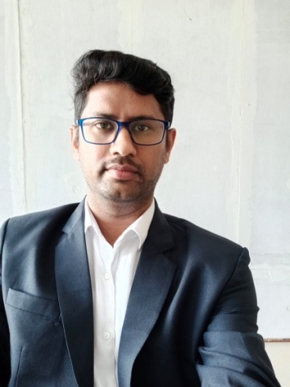
Faculty Name - Mr. Vinayak K. Mhaismale
Qualification – M.Pharma (Pharmaceutics)
Ph.D in Pharmaceutics (Pursuing)
Experience – 10 Years
Research area - Novel drug delivery system formulation and development.
Practical - Internal exam incharge

Slide 6
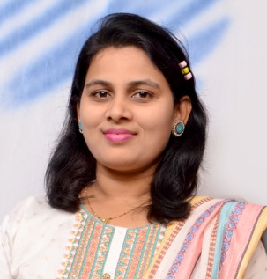
Faculty Name – Ms. Rashmi Tambare
Qualification – M.Pharma (Pharmaceutics)
PhD (Pursuing) (BAMU, A’bad)
Experience – 08 Years
Research paper published : 05
Research area – Nanoparticulate drug delivery system, Depot drug delivery System
Achievements – Appreciated as a Team manager of BATU for “Avishkar 2023”
Nominated as women leaders / Qualified GPAT (2014) (2017) Qualified PET (2020)

Slide 7
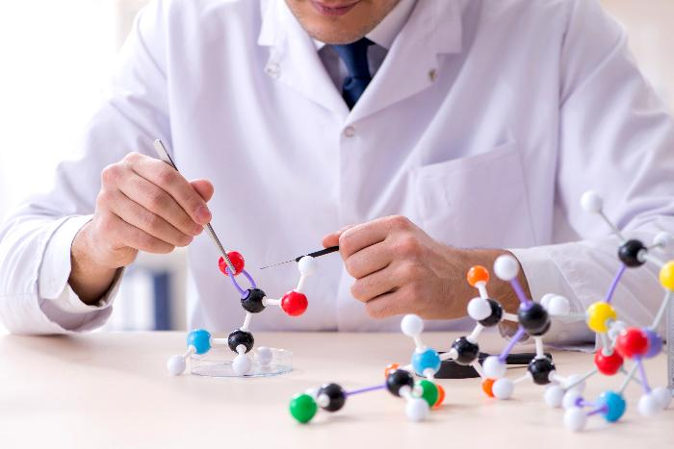
Department of Pharmaceutical Chemistry

Slide 8
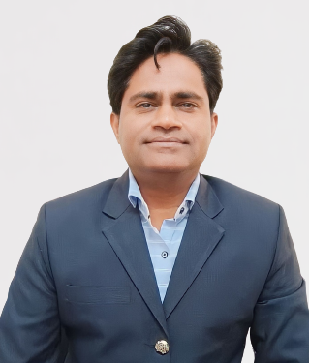
Faculty Name - Dr. Mangesh S. Ghodke
(HoD – Pharmaceutical Chemistry)
Qualification – M. Pharma (Pharma Chemistry)
Ph. D in Pharma Chemistry
Experience – 17 Years
Research paper published : 24
Book published :– 1) Synthesis of Essential Medicinal Compounds
2) Design, Synthesis & Pharmacological screening of some Nitrogen, Sulphur containing novel Heterocycles
Research area - Synthetic Medicinal Chemistry, Nervous System area related work
Achievements – GPAT 2019 (Percentile - 97%)

Slide 9
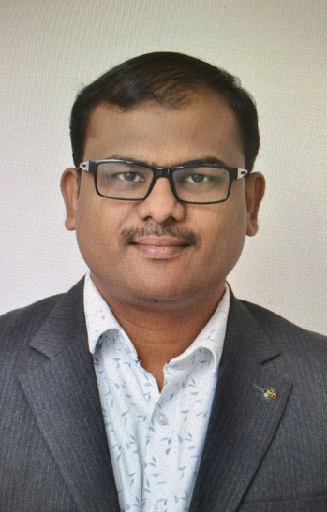
Faculty Name - Dr. Sachin A. Dhawale
Qualification – M. Pharm. (Pharmaceutical Chemistry),
DST-Research Scholar Ph.D. (Pursuing)
Experience – 08 Years
Research paper published : 22
Research area – Designing of Novel NCE, Anticancer studies,
Advanced Computational Studies and drug design.
Awards - Recipient of GOLD medal in research competition - Avishkar 2023
Achievements - Recipient of First prize winner in the international conference-2022.
Sports Incharge

Slide 10

Department of Quality Assurance

Slide 11
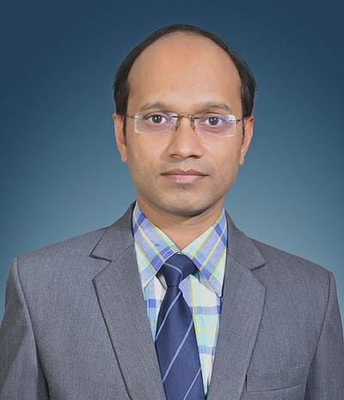
Faculty Name - Dr. Vishal C. Gurumukhi
(HoD – Quality Assurance, Pharmacology Pharmacognosy,)
Qualification – M. Pharm. (Quality Assurance),
Ph. D. (Pharmaceutical Science)
Experience – 15 Years
Research paper published : Total (International 07/ National 07)
Total Impact factor: 26.79
Book chapter published: 3
Book published: 1 (Pharmacy Practice)
Research area – Nano-particulate drug delivery system, Nano-emulsion, Nanosuspension

Slide 12
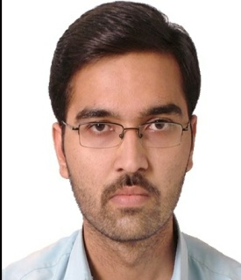
Faculty Name: Mr. Tushar Joshi
Qualification – M.Pharma (QA)
Experience – 08 Years
Research paper published : 03
Research area – Formulation development
Achievements – GPAT (2017, 2021), PET (2021)
Exam incharge

Slide 13
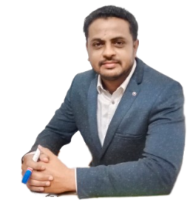
Faculty Name: Mr. Amol N. Lonarkar
Qualification – M. Pharma (QA)
Experience – Industrial Experience 07 Years
- Academic experience 01 Years
Research paper published : 01
Research area – Pharmaceutical Regulatory affairs
Achievements – RA Dept Manager in MNC : Microgen Hygine PVT LTD

Slide 14
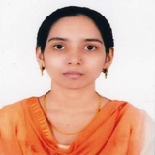
Faculty Name: Dr. Darakhshan Afreen Shaikh
(Associate Professor - Department of Quality Assurance)
Qualification: M-Pharmacy (Quality Assurance), Ph.D.(Technology)
Experience: 09 years
Research Papers Published: 09 National: 01 International: 08
Poster Presentations:05
Patents: 02 National: 01 International: 01
Book Chapters: 01
Achievements:
Goldmedalist
BAMU First University Topper B-Pharm+M-Pharm (Six Years).
Vaishvik Shikshak Ratan Award 2024.
Nari Shakti Shiromani Award 2023.
Biblography Published in Asian Admirable Achievers.2023.
Best Educationist Award 2022.
Bharat Gaurav Puraskar 2022.
Dr. APJ Abdul Kalam Lifetime Achivement National Award 2021.
PG Guide (in Quality Assurance) approval from Mumbai University.
Young Achiever Award 2018.
Dr. Madhusudhan Bhaskar Gharpure Paritoshak Award 2013.
Qualified GPAT 2013.

